Slide 1

A Hands-on Exploration with Manual Convolution
A conceptual understanding of the feature detection process in CNNs
Team name – AI Hawks
Group members – Jaya Verma
Quyen D
Binte Zahra
John Mata

Slide 2
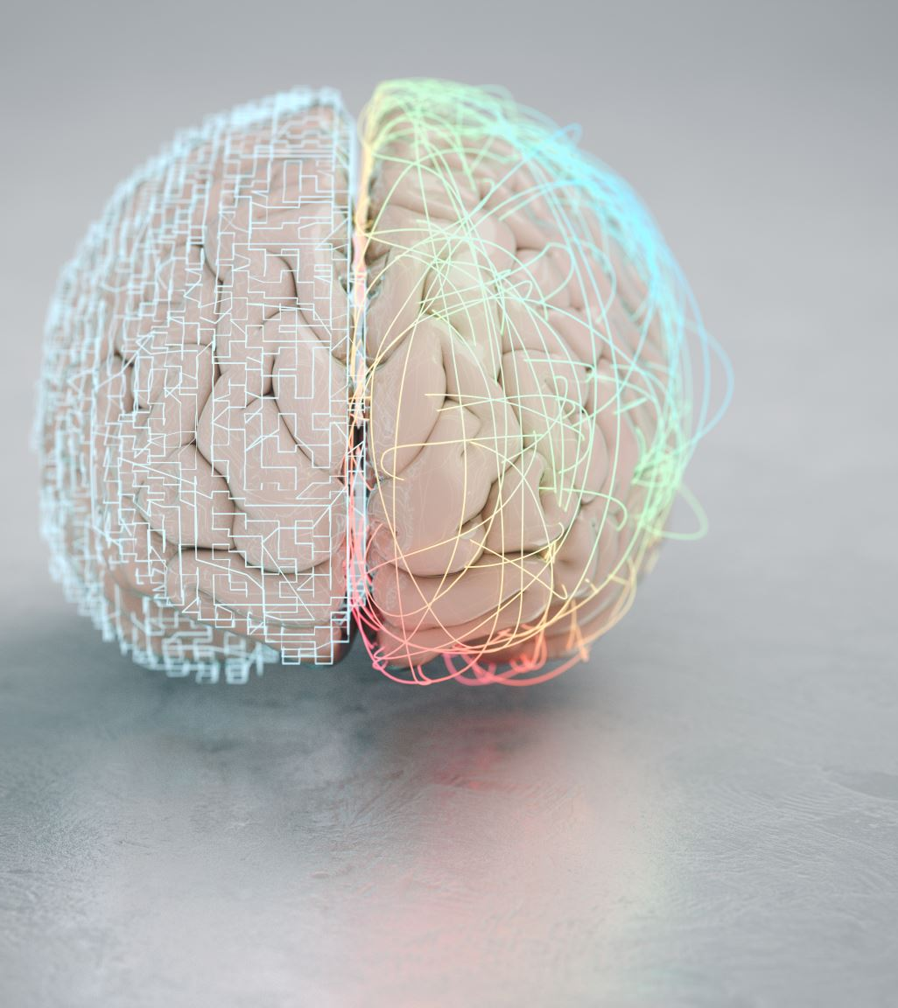
Introduction
Neural networks are computational models inspired by the human brain.
CNN (Convolutional Neural Network) specializes in image recognition tasks.
Components of a CNN are –
Convolutional Layers, Filters/Kernels, Activation Functions, and Pooling Layers

Slide 3
8x8 Image of a Square
0 | 0 | 0 | 0 | 0 | 0 | 0 | 0
0 | 1 | 1 | 1 | 1 | 1 | 1 | 0
0 | 1 | 1 | 1 | 1 | 1 | 1 | 0
0 | 1 | 1 | 1 | 1 | 1 | 1 | 0
0 | 1 | 1 | 1 | 1 | 1 | 1 | 0
0 | 1 | 1 | 1 | 1 | 1 | 1 | 0
0 | 1 | 1 | 1 | 1 | 1 | 1 | 0
0 | 0 | 0 | 0 | 0 | 0 | 0 | 0
Sample image that will be used to demonstrate convolutional neural network manually.
The sample image is an 8 x 8 matrix representing a square with 0’s and 1’s to demonstrate the color distribution.

Slide 4
Using Filter/Kernel for Edge Detection
Vertical (a) and Horizontal (b) Edge Detection Filters (Kernels):
Kernels are small matrices used to highlight edges or boundaries within an image.
The input image is convoluted with the filter/kernel to determine changes in intensity.
-1 | 0 | 1
-1 | 0 | 1
-1 | 0 | 1
-1 | -1 | -1
0 | 0 | 0
1 | 1 | 1
(a)
(b)

Slide 5
Calculation of grid cells and Output image for Vertical edge detection
-1 | 0 | 1
-1 | 0 | 1
-1 | 0 | 1
0 | 0 | 0 | 0 | 0 | 0 | 0 | 0
0 | 1 | 1 | 1 | 1 | 1 | 1 | 0
0 | 1 | 1 | 1 | 1 | 1 | 1 | 0
0 | 1 | 1 | 1 | 1 | 1 | 1 | 0
0 | 1 | 1 | 1 | 1 | 1 | 1 | 0
0 | 1 | 1 | 1 | 1 | 1 | 1 | 0
0 | 1 | 1 | 1 | 1 | 1 | 1 | 0
0 | 0 | 0 | 0 | 0 | 0 | 0 | 0
2 | 0 | 0 | 0 | 0 | -2
3 | 0 | 0 | 0 | 0 | -3
3 | 0 | 0 | 0 | 0 | -3
3 | 0 | 0 | 0 | 0 | -3
3 | 0 | 0 | 0 | 0 | -3
2 | 0 | 0 | 0 | 0 | -2
*
Here, we are calculating the output image of every single cell - example
0x(-1) + 0x0 + 0x1 + 0x(-1) + 1x0 + 1x1 + 0x(-1) + 1x0 + 1x1 = 2

Slide 6
Calculation of grid cells and Output image for Horizontal edge detection
-1 | -1 | -1
0 | 0 | 0
1 | 1 | 1
0 | 0 | 0 | 0 | 0 | 0 | 0 | 0
0 | 1 | 1 | 1 | 1 | 1 | 1 | 0
0 | 1 | 1 | 1 | 1 | 1 | 1 | 0
0 | 1 | 1 | 1 | 1 | 1 | 1 | 0
0 | 1 | 1 | 1 | 1 | 1 | 1 | 0
0 | 1 | 1 | 1 | 1 | 1 | 1 | 0
0 | 1 | 1 | 1 | 1 | 1 | 1 | 0
0 | 0 | 0 | 0 | 0 | 0 | 0 | 0
2 | 3 | 3 | 3 | 3 | 2
0 | 0 | 0 | 0 | 0 | 0
0 | 0 | 0 | 0 | 0 | 0
0 | 0 | 0 | 0 | 0 | 0
0 | 0 | 0 | 0 | 0 | 0
-2 | -3 | -3 | -3 | -3 | -2
*

Slide 7
Output image and conclusion
2 | 0 | 0 | 0 | 0 | -2
3 | 0 | 0 | 0 | 0 | -3
3 | 0 | 0 | 0 | 0 | -3
3 | 0 | 0 | 0 | 0 | -3
3 | 0 | 0 | 0 | 0 | -3
2 | 0 | 0 | 0 | 0 | -2
Vertical edge detection output
Grid shows the strength of the vertical and horizontal edges detected in the original image.
Positive values (e.g., 1, 2, 3) indicate edges where the intensity increases from left to right in vertical edge and in horizontal image it increases from top to bottom.
Negative values (e.g., -2, -3) indicate edges where the intensity decreases from left to right in vertical and top to bottom in horizontal.
Values near 0 indicate areas with little to no vertical or horizontal edge.
2 | 3 | 3 | 3 | 3 | 2
0 | 0 | 0 | 0 | 0 | 0
0 | 0 | 0 | 0 | 0 | 0
0 | 0 | 0 | 0 | 0 | 0
0 | 0 | 0 | 0 | 0 | 0
-2 | -3 | -3 | -3 | -3 | -2
Horizontal edge detection output
Notes:
The shade of the transitions is positive number to negative. And the positive numbers shows that this is a light to dark transition.

